Slide 1
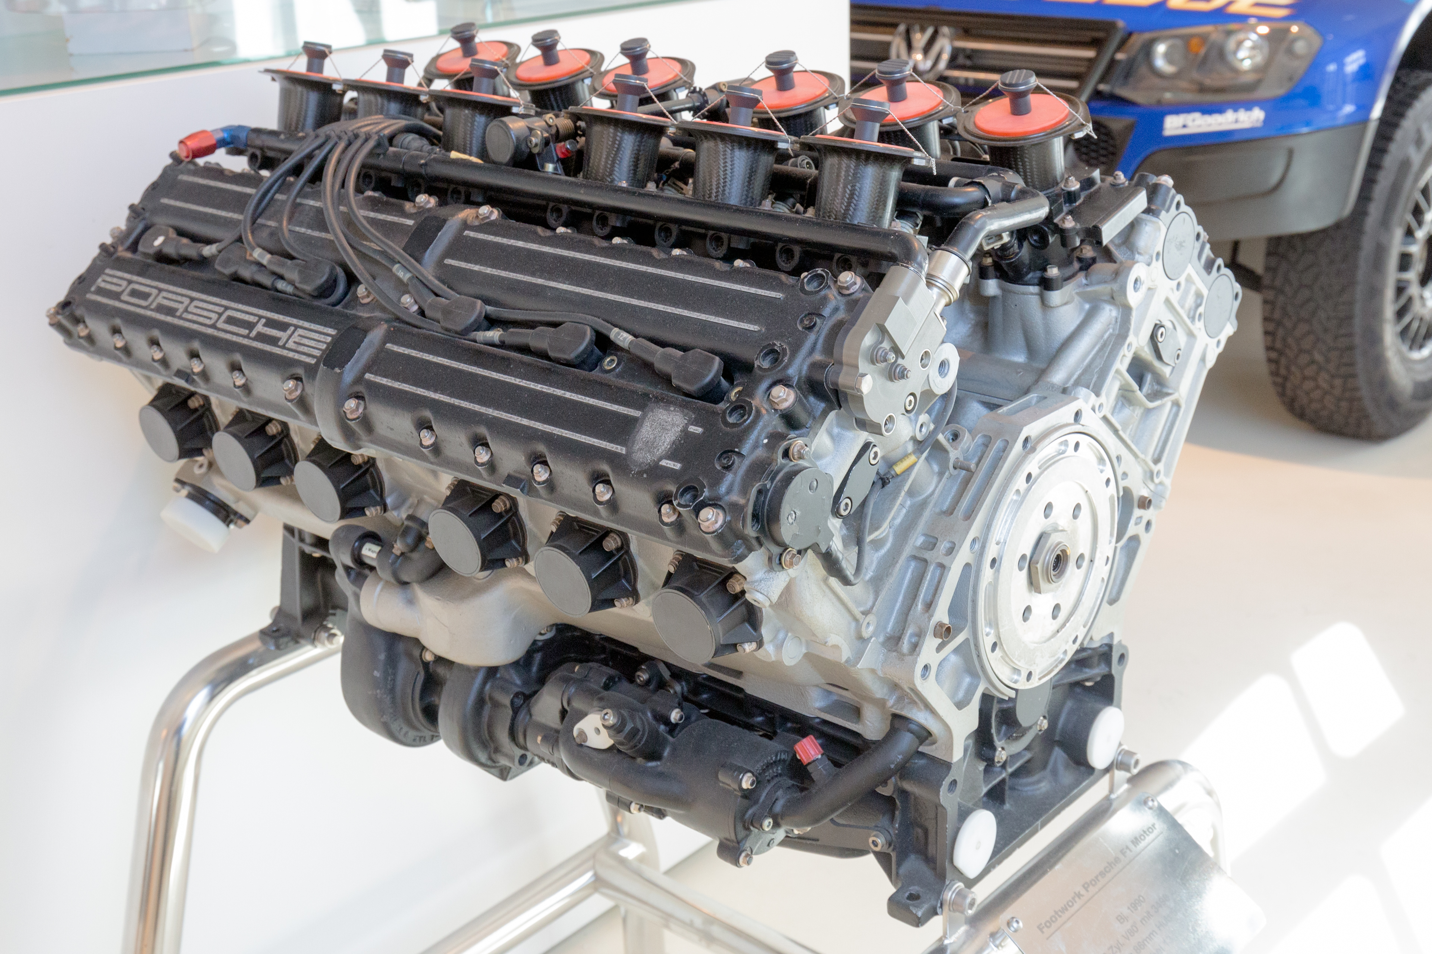
engine
An engine is a machine designed to convert one form of energy into mechanical energy.
Common forms of energy include heat, light, sound, and kinetic.

